Slide 1
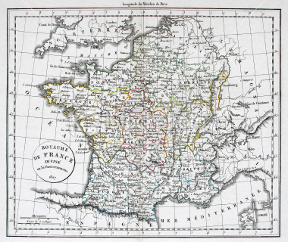
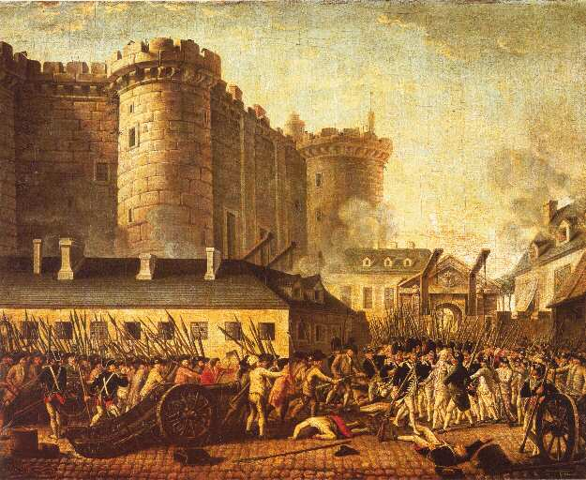
The French Revolution & Napoleon, 1789-1815
“We are not to expect to be translated from despotism to liberty in a featherbed.” Thomas Jefferson

Slide 2
What famous people have said about violence…
“Democracy don’t rule the world, You’d better get that in your head; This world is ruled by violence, But I guess that’s better left unsaid.”—Bob Dylan
“Violence isn’t always evil. What’s evil is the infatuation with violence.”—Jim Morrison
“There are only two forces in the world, the sword and the spirit. In the long run the sword will always be conquered by the spirit.”—Napoleon Bonaparte
Think, share, respond, & debate

Slide 3
CRASH COURSE in FR (1st 3 minutes only)
https://www.youtube.com/watch?v=lTTvKwCylFY

Slide 4
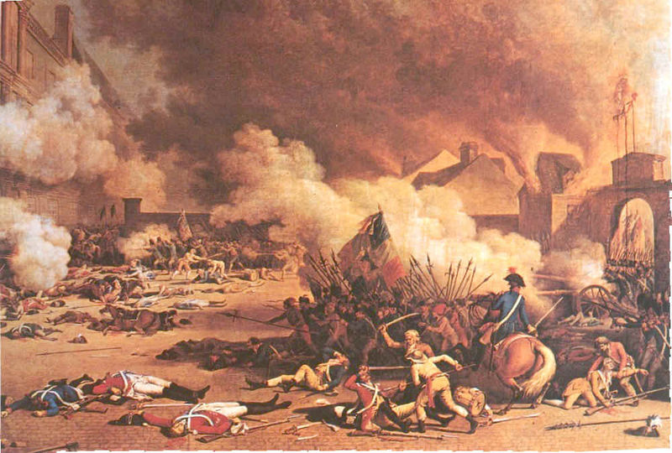
Would you join the mob??
Go to p. 192, look a the picture, and answer the questions.
Notes:
Have class explain on a note card what they would do (write letter to king, sign petition—warn that violence/revolution will come, OR revolt immediately)

Slide 5
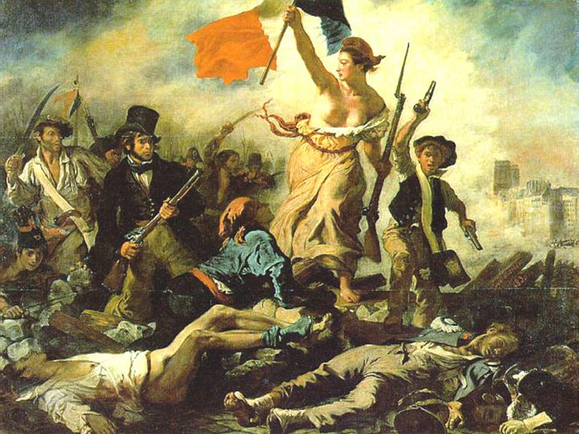
Critically think……
How would you define an unjust government?
When is revolution justified? (Big Idea #1)

Slide 6
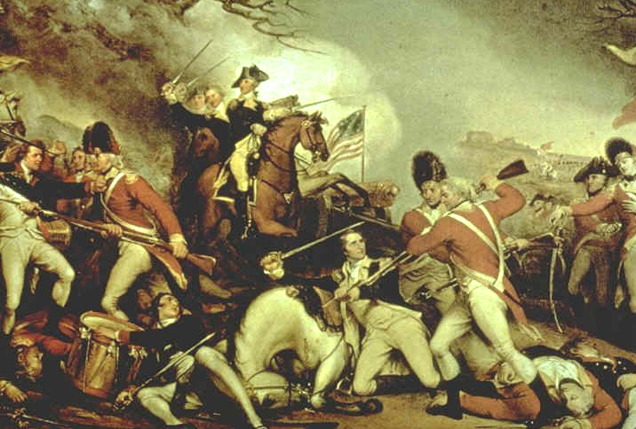
Forces of change in France (Causes of the FR)
Growing resentment within the lower classes (rejection of Absolutism)
Enlightenment ideas
The success of the American Revolution
Failing Economy
A Weak Leader

Slide 7
The Old Regime: A system of feudal class
FIRST ESTATE
Made up of clergy of Roman Catholic Church
Scorned Enlightenment Ideas
Contributed 2% of income in taxes
SECOND ESTATE
Made up of rich nobles
Held highest offices in government
Scorned Enlightenment ideas
NO TAXES!!!
THIRD ESTATE
Included bourgeoisie, urban lower class and peasants
Had no power to influence government—privileged estates could always outvote 3rd
Embraced Enlightenment ideas
Paid 50% of income in taxes to support the privileged
The Privileged Estates
The Third Estate

Slide 8
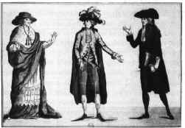
Why are the 1st and 2nd estates opposed to Enlightened Ideas?
No reason to desire change since they already had privileges and wealth
Threatened their status and power
Notes:
Some would argue this is similar to conservatives today. Wealthy don’t want to give up any of their “hard earned” money.

Slide 9
Old Regime
Notes:
1st clergy (paid 2% taxes) 2nd nobility (no taxes): 2%, 3rd 98% paid 50% of income for taxes to support the privileged in 2nd estate

Slide 10
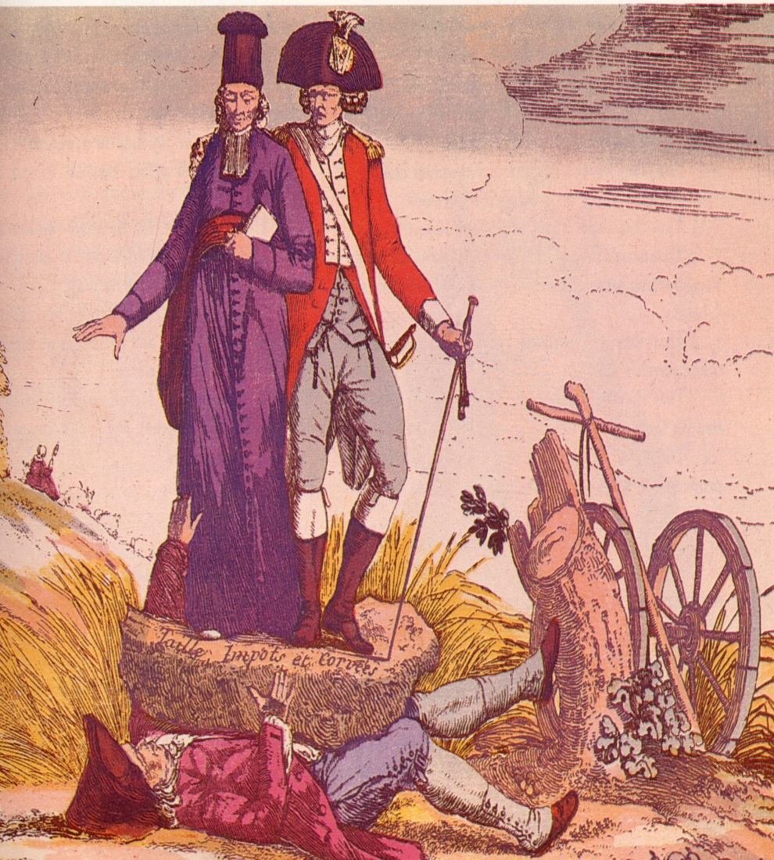
Analyzing Political Cartoons
How does this cartoon depict the Old Regime?
What does the boulder represent?
Notes:
Page 194: 1st and 2nd oppress the 3rd and hold them down with the burden of taxes—this is the situation pre-revolution

Slide 11
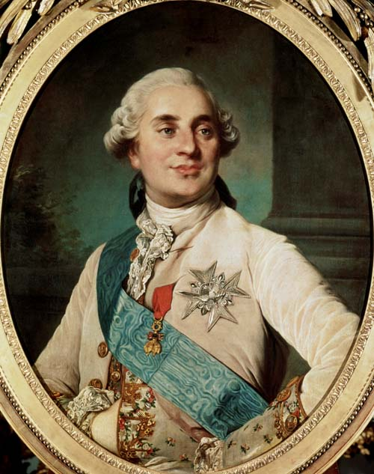
King Louis XVI…..a weak leader
King Louis XIV, was his great-great-great grandfather
Ruled for 17 yrs (1774-1791)
After being removed from power, he was given the last name of Capet (they thought it was a family name)….some nicknamed him Louis le Dernier (Louis the Last)
Executed in 1793
Louis XVI = indecisive & paid little attention to government advisors
Despite being one of the most advanced countries in the world at the time, there are 3 reasons why France was in dire financial conditions:
*Spent lots of $ on French-Indian War
*Borrowed heavily to help American revolutionaries (common enemy – GB)
*King, Queen, and nobility consuming remaining wealth to maintain their luxurious lifestyles

Slide 12
Marie Antoinette (Trailer)

Slide 13
Historical Wife Swap!
http://www.youtube.com/watch?v=dHHp6xqEc8c

Slide 14
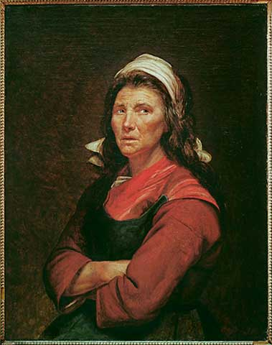
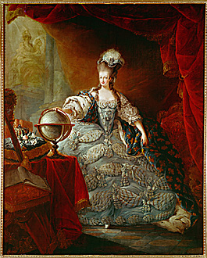
History through Art
Go to p. 195 to answer questions (compare and contrast)
on these two pictures
A Woman of the Revolution (1795), Jacques Louis David
Marie Antoinette, (Madame Defecit) Jacques Gautier d’Agoty
Notes:
GAP BTWN rich and poor in 18th ctry france is clear in these 2 portraits. Common woman’s appearance displays none of the luxery of the french court. Compare clothing, expression, posture

Slide 15
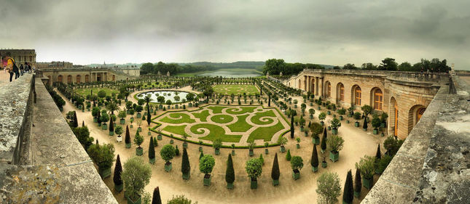
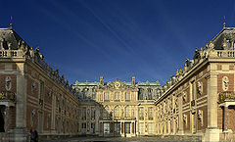
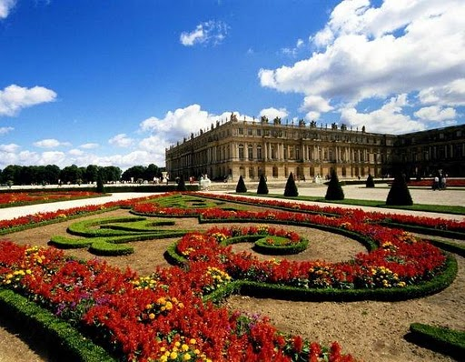
The Palace of Versailles
Did living at Versailles (and its 700 rooms) make it harder for Louis XVI and Marie Antoinette to be good leaders? (Story of Cory Booker)
Notes:
Put distance between him and his subjects by living in Versailles. Picture of perfection, order, glamour.

Slide 16
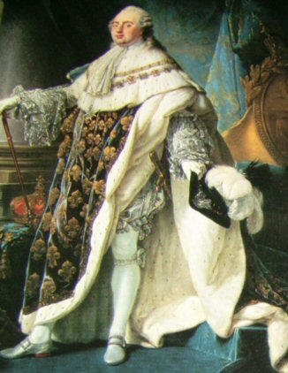
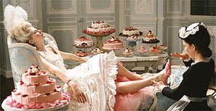
Just how out of touch with reality were the King and Queen?
On day the Bastille fell in Paris, king wrote “nothing” in his diary—a reference to his lack of success in the hunt
At some point around 1789, when being told that her French subjects had no bread, Marie-Antoinette supposedly sniffed, “Qu’ils mangent de la brioche”—“Let them eat cake.” With that callous remark, the queen became a hated symbol of the decadent monarchy. Most historians agree, however, that she did not say this. Despite her spending habits, she did contribute to charitable organizations in France (but it was not nearly enough)

Slide 17
Thoughts on Poverty
Reflect: 1. How do you feel about the gap between rich and poor that exists in our world today? 2. Should the government try to decrease this gap and display a greater concern for global welfare? Whose obligation is it?
3. Does the “3rd estate” exist in the world today?
Notes:
Voiceless, no education, no tools to revolt against unfairness, no chance to get involved in politics and make a difference. At the same time, many would argue that we are doing our part in america. We give more than any other country to the UN which conducts a number of humanitarian relief programs—but is it enough relative to what we Could be doing….

Slide 18
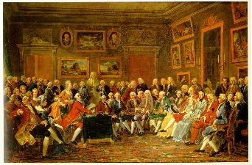
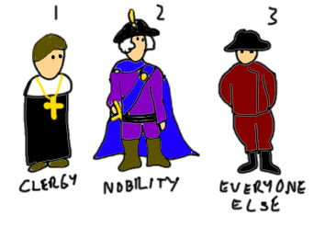
Check for Understanding
In what ways did Enlightenment ideas fuel the revolution?
How did economic and social inequality play a role in the French Revolution?
(Bono story….the house on
the hill)
Notes:
Can work in partners but must be ready for ball toss to share answers

Slide 19
5 Stages of the French Revolution
Stage One
Spring and Summer of 1789
Meeting of the Estates-General
Storming of the Bastille
The Great Fear
Stage Two
1789-1791
National Assembly
Declaration of the Rights of Man
Constitution of 1791
Stage Three
1791-1792
Legislative Assembly
Emergence of 3 political groups
September Massacre
Stage Four
1792-1795
National Convention
Reign of Terror
Committee of Public Safety
Thermodorian Reaction
Stage Five
1795-1799
Directory
Coup d’etat

Slide 20
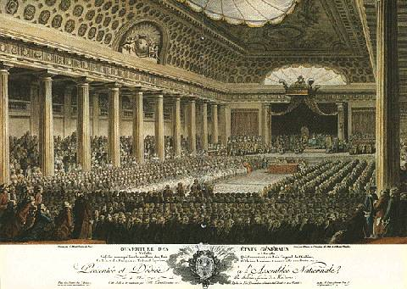
Stage 1 - Meeting of the Estates-General 1789
The Second Estate forces Louis to call meeting of the Estates-General, an assembly of representatives from all 3 estates
First meeting of its kind in 175 years

Slide 21
Abbé Sieyès (clergyman sympathetic to cause of the Third Estate….became their spokesman)
He said, “What is the 3rd estate? Everything. What has it been up to now in the political order? Nothing. What does it demand? To become something herein.”
He suggested 3rd Estate name themselves the National Assembly -pass laws and reforms in the name of the French people
It is a major segue to the revolution

Slide 22
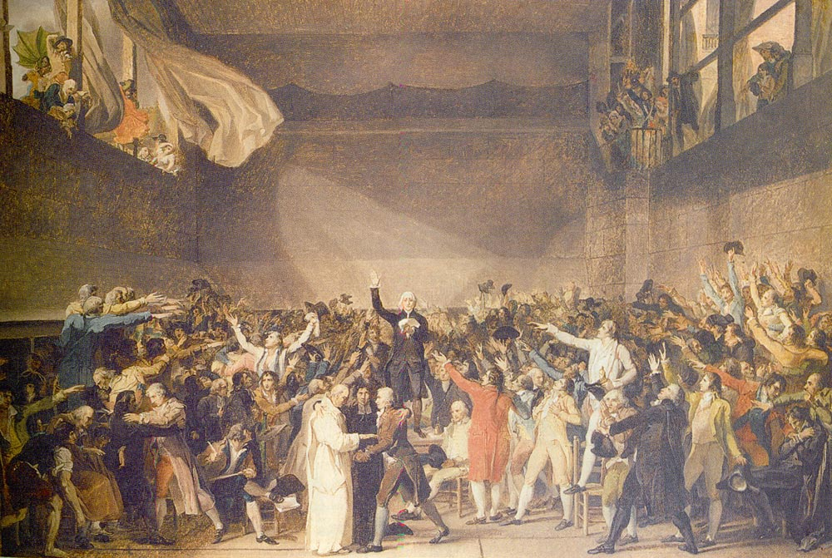
Tennis Court Oath
So shortly after the American Revolution, they voted to establish the National Assembly on June 17, 1789.
This was to mark the end of the Absolute Monarchy and the beginning of a representative government.
Three days later, the Third Estate delegates (National Assembly) found themselves locked out of their meeting room at Versailles.
They broke down the door to an indoor tennis court, pledging to stay until they had drawn up a new constitution.
This pledge became known as the Tennis Court Oath!

Slide 23
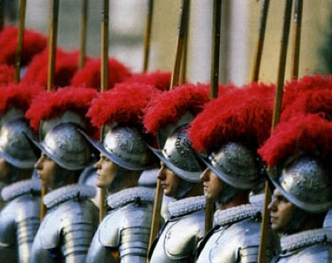
Troops & Rumors
After Tennis Court Oath, Louis tried to make peace by yielding to National Assembly’s demands.
Louis ordered nobles and clergy to join Third Estate in the National Assembly.
Sensing danger, Louis stationed Swiss guards in Paris since he no longer trusts the loyalty of the French soldiers.
Rumors flew that foreign troops were coming to massacre French citizens. People gathered weapons in order to defend Paris against the king’s foreign troops. This would lead to……

Slide 24
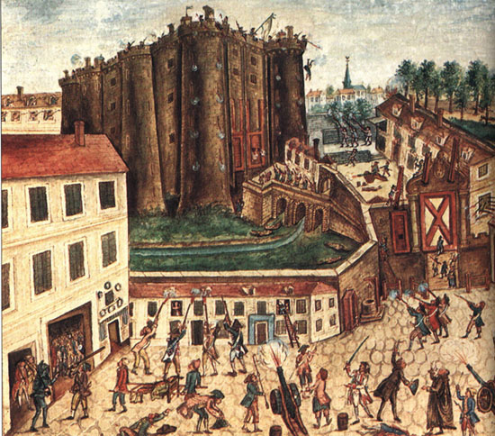
Fall of the Bastille – July 1789
On July 14th, a mob tried to get gunpowder from the Bastille, a Paris prison.
The Bastille fell into the control of the citizens. This effectively starts the Revolution (1789). Remember, they used the stones from it to build a bridge so that it would “ always be trampled upon”
The fall of the Bastille became a great symbolic act of revolution to the French people. Every July 14th, France celebrates Bastille Day (Independence Day)

Slide 25
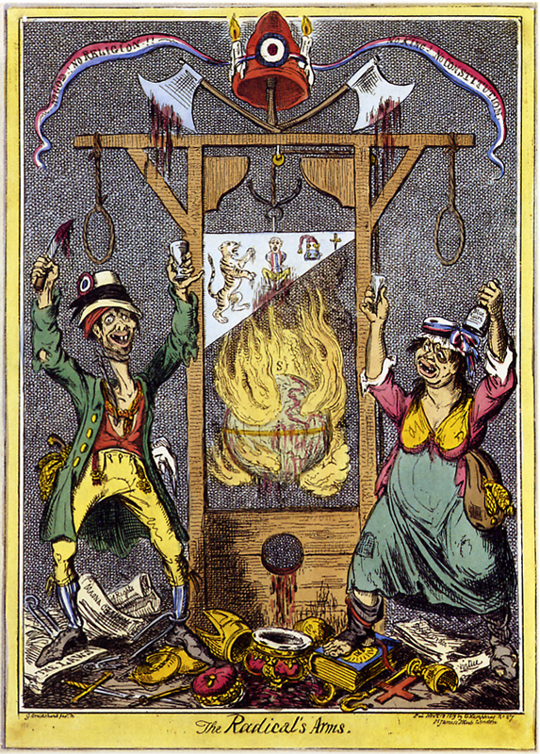
A Great Fear Sweeps Across France…
Rumors spread that the nobles were hiring outlaws to terrorize the peasants→rebellions
The Great Fear rolled through France with a senseless panic.
When the peasants met no enemy bandits, they became outlaws themselves.
Notes:
What do the peasants do?

Slide 26
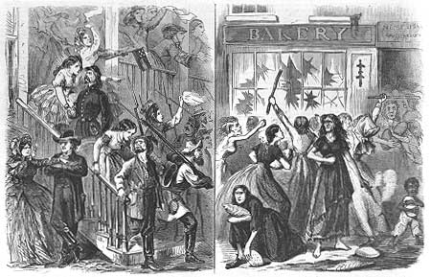
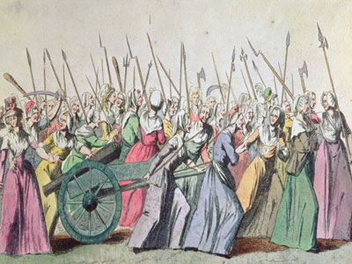
The Women’s March – October 1789
Notes:
These women later became heroes of the revolution. In bringing royal family to Paris, they achieved ________

Slide 27
The Women’s March (October 1789)
6,000 Parisian women rioted over the rising price of bread and marched to Versailles (6 hrs on foot). This is a root of the FR. (connection: Hurricane Katrina / looting).
They broke into Versailles, killed 2 guards putting their severed heads on poles, and demanded that Louis and Marie Antoinette return to Paris with them.
They both separately greet the crowd from a balcony and agree to doing this.
The crowd has picked up volume (up to 60,000). The march back to Paris takes 9 hours and the royal family will go willingly.
They triumphantly returned with flour and the entire royal family (2 children).

Slide 28
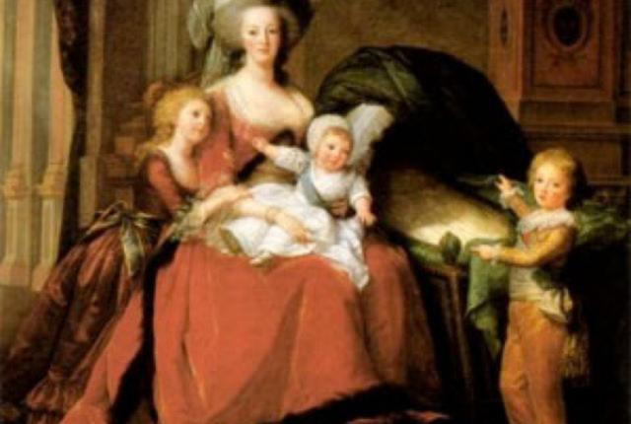
The Royal Children
7 years after their marriage, Louis and Marie had their 1st child, a girl which was not desired by the monarchy. A male heir is needed!
Marie Therese (would live to the age of 72….a unhappy life)
Louis Joseph (died at age of 7, 2 years after Sophie, likely from TB)
Louis Charles (tormented/abused after his parents were executed….died at age 10 from TB exacerbated from cruel prison conditions/abuse)
Sophie (born premature, died one month shy of her 1st birthday)

Slide 29
The Women’s March and return to Paris, continued…..
They are brought to the Tuileries palace (which has been vacant since the time of King Louis the XIV). It is old and dilapidated…. A far cry from Versailles)
He was asked for his orders and he replied with uncharacteristic indifference, "Let everyone put himself where he pleases!" Then sullenly, he asked for a history of the deposed Charles I of England to be brought from the library.
The Royal Family sees the writing on the wall!

Slide 30
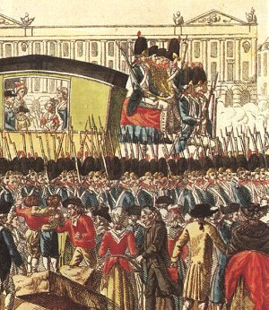
Meanwhile…Louis tries to escape!
←Louis returns to Paris after his failed escape and is being held at another palace….not Versailles
Louis tries to take his family to the Austrian Netherlands
A postmaster recognizes his face and he is sent back under military guard

Slide 31
Opinions…
Do you think that the French Revolution was inevitable?
Why or why not? (3-5 sentences)
Then, now, and in the future?

Slide 32
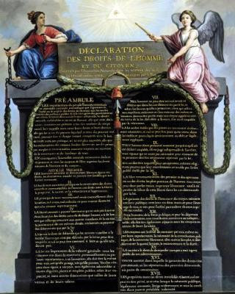
Stage 2 - The Old Regime Dies!
Fear motivates the nobles and clergymen to put an end to the Old Regime!
The National Assembly (used to be the 3rd Estate) adopts the Declaration of the Rights of Man (1789), influenced by Enlightenment ideas and the Declaration of Independence (1776).
Are women included in the Rights of Man??? Let’s got to p. 197 in text.

Slide 33
Stage Three-Legislative Assembly
RADICALS (Jacobins)
Opposed monarchy
Made up of peasants, intellectuals, urban working class
Sans Culottes
Jacbobins
MODERATES
Wanted some change but not as much as Radicals
Made up of Bourgeoisie
Girondins
CONSERVATIVES
Wanted a limited monarchy
Made up of Bourgeoisie and some nobility
Liberals (D) Moderates Conservatives ( R )

Slide 34
The Wheels are coming off the Royal Carriage….
Austria and Prussia (old Germany, Poland, Latvia, Lithuania…) want to preserve monarchy. They insist that the French put Louis back in charge.
Why are they interested in France retaining a monarchy?
Because if the French Monarchy falls they fear what could happen to them as well. Domino Theory!!!
Legislative assembly responds to these foreign monarch demands by declaring war on Austria (Prussia joins Austria later in the war against the French people).
The war did not start out well for the French. Thus, the Prussian commander threatened to destroy Paris if the revolutionaries harmed any member of the French Royal family.
Outraged by this statement, 20,000 men and women invaded the Tuileries, the royal palace where Louis and his family were staying. The mob brutally massacres the Swiss guard of 900 men and imprison the Royal family.
See p. 199 for a voice from the past.

Slide 35
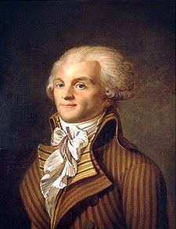
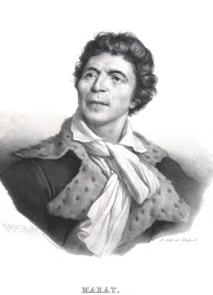
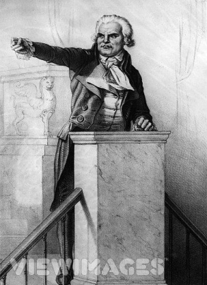
Stage Four-National Convention
Faced with the threat of the Parisian radicals, the Legislative Assembly gives up the idea of a limited monarchy.
1791, Constitution is passed (4 years after US)
They depose the king (removed from throne) and dissolve the Legislative Assembly (the name has changed twice already).
The new governing body is going to be called the National Convention. It is made up of radical leaders from the Jacobin Club. They supported a REPUBLIC.
3 Main Players/Leaders:
Maximilien Robespierre – “The Incorruptible”
Jean Paul Marat – writer for a radical
newspaper (“Friend of the People”)
George Danton - great orator
(part of Robespierre’s inner circle)

Slide 36
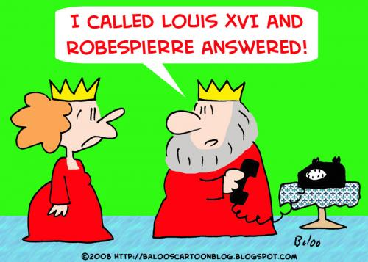
Stage Four-National Convention
REIGN OF TERROR
“The first maxim of our politics ought to be to lead the people by means of reason and the enemies of the people by terror.” ~Robespierre
Goal: use terror to enforce the Republic’s virtues
Committee of Public Safety (12 man panel)
-created and lead by Robespierre…dictator-like
-seek out enemies of the Republic
-try and execute enemies of the Republic in
an equal manner
-40,ooo executed by the guillotine alone; mostly 3rd Estate
Infamous executions :
Louis XVI-King of France
Marie Antoinette-Queen of France
George Danton-a leader of National Convention

Slide 37
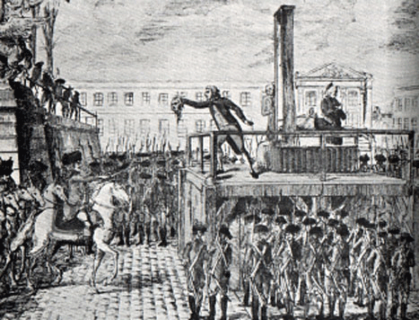
Radicals Execute the King
National Convention reduces Louis XVI’s role from that of a king to that of a common citizen and prisoner.
Guided by Jacobins, the Convention tried Louis for treason and found him guilty.
Louis is beheaded by the guillotine.
**

Slide 38
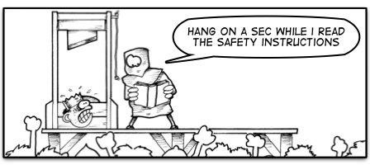
Execution of Louis XVI
Louis XVI-King of France
Executed Jan 21, 1793
Said to have cried like a baby as he climbed the scaffolding
Symbolic event signifying the emergence of a true radical republic

Slide 39
Execution of Marie Antoinette
Marie Antoinette- Queen of France
Executed on Oct. 16, 1793
Was never liked by the people of France
Was executed as a traitor for conspiring against France with her brother the Emperor of Austria
Was said to have been very stoic on the scaffolding. Accidentally, she stepped on the executioner’s foot and said “Excuse me, sir”.

Slide 40
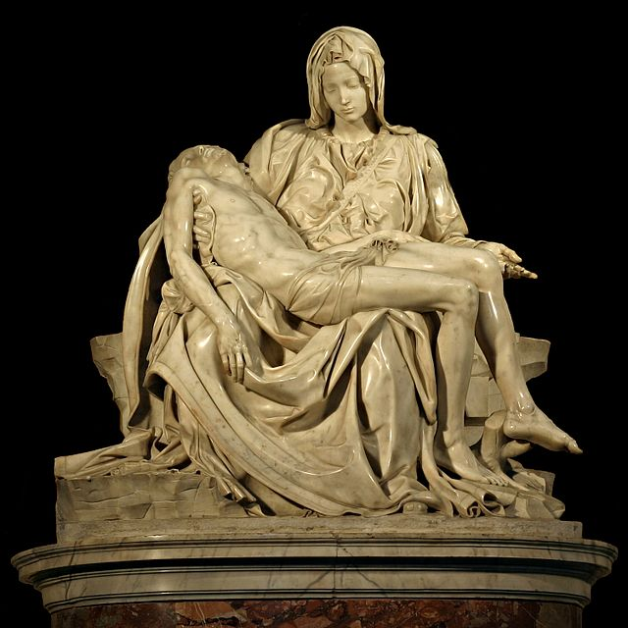
Murder of Jean Paul Marat
Jean Paul Marat
Writer and publisher of “The Friend of the People”.
Murdered by Charlotte Corday in his medicinal bath tub on July 13, 1793.
She was appalled by the brutality that was going on in Paris (she was from a small town outside of Paris).
She thinks Marat is fully responsible for the all of the senseless killing and wanted an end to the violence.

Slide 41
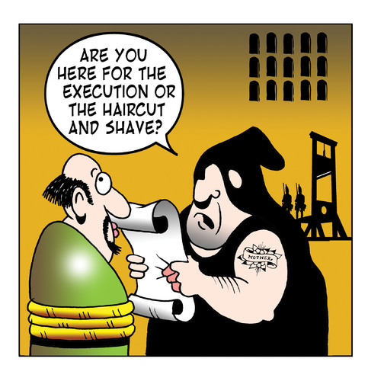
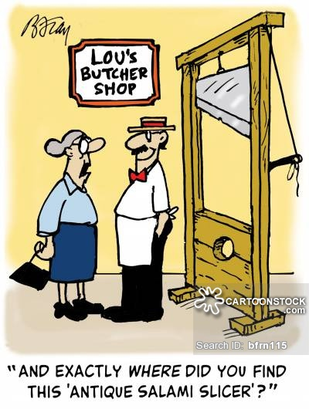
Guillotine PPT and video clip

Slide 42
The End of the Reign of Terror
Great Fear (wave of panic after Storming of the Bastille) – Reign of Terror – Great Terror is time within the Reign of Terror
During the Great Terror (the last few months) thousands were sent to death on the flimsiest of charges. Example-a tavern keeper was executed because he sold sour wine to the defenders of the country.
The National Convention knew that none of them were safe from Robespierre. To save themselves, they turned on him (Shouting: “Down with the tyrant”), demanded his arrest, and beheaded him.
The Reign of Terror, the radical phase of the French Revolution, was over when Robespierre lost his head, July 28, 1794.

Slide 43
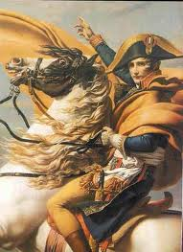
Stage 5 - A New Government
French public opinion shifted dramatically to the right after Robespierre’s death. People of all classes had grown weary of the Terror.
Moderate leaders in the National Convention drafted a new plan of government.
The third government since 1789, the new constitution placed power firmly in the hands of the upper middle class and called for a two-house legislature and an executive body of five men, known as the Directory.
These directors were moderates, not revolutionary idealists (didn’t represent the will of the people). Despite their corruption, they gave their troubled country a period of order.
The Directory chose Napoleon Bonaparte as the general for France’s armies. He is regarded by many historians as the greatest military strategist of all time.

Slide 44
The Congress of Vienna (1814-1815)
European heads of government were looking to establish long-lasting peace and stability on the continent after the defeat of Napoleon.
Their goal was collective security and stability
A series of meetings in Vienna, known as the Congress of Vienna, were called to set up policies to achieve this goal
Main players: Prussia, Russia, Austria, Britain, France
Most influential figure was the foreign minister of Austria, Prince Klemens von Metternich, who distrusted the democratic ideals of the French Revolution.
He felt that Napoleon’s expansionist dictatorship had been a natural outcome of experiments with democracy Why would aristocrats be against democracy?

Slide 45
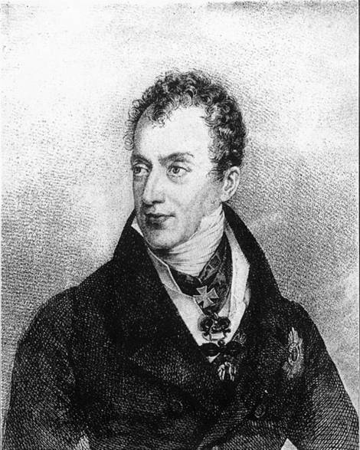
Goals of Metternich
To prevent future French aggression by surrounding France with strong countries
To restore a balance of power so that no country would be a threat to others
To restore Europe’s royal families to the thrones they had held before Napoleon’s conquests
Metternich remarked, “The first and greatest concern for the immense majority of every nation is the stability of laws—never their change.”

Slide 46
The Containment of France
The Congress made the weaker countries around France stronger:
Austrian Netherlands and Dutch Republic united to form the Kingdom of the Netherlands
Group of 39 German states were joined as the German Confederation, dominated by Austria
Switzerland became an independent nation
Kingdom of Sardinia in Italy was strengthened by the addition of Genoa
Allowed the countries of Europe to contain France and prevent it from overpowering weaker nations.

Slide 47
Balance of Power
The victorious powers were easy on the defeated nation.
The French were required to give up the territories Napoleon had taken, but France remained intact.
This was done so that there was a balance of power in Europe; no country could easily overpower another.
Would you have done the same if you were one of the influential players at the Congress?

Slide 48
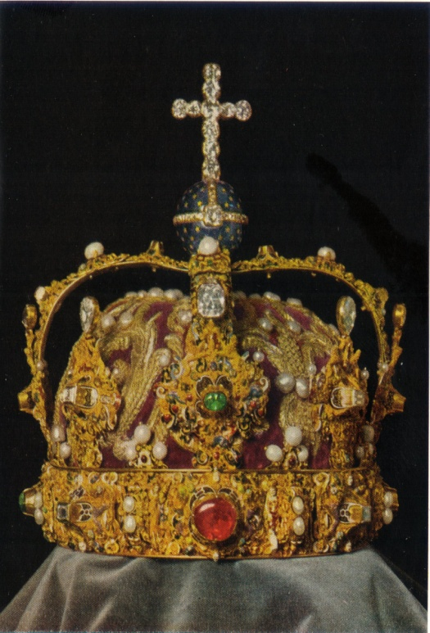
Legitimacy
The great powers affirmed the principle of legitimacy—agreeing that as many as possible of the rulers whom Napoleon had driven from their thrones should be restored to power.
The participants in the Congress of Vienna believed that the return of the former monarchs would stabilize political relations among the nations.
King Louis XVIII returns to power in France and rules in a constitutional monarchy.
How successful was the French Revolution?

Slide 49
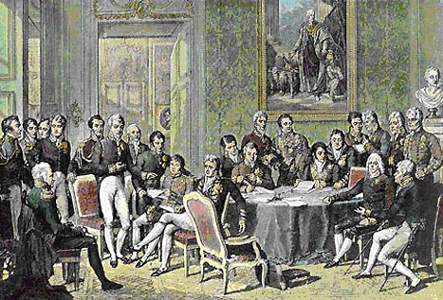
Congress of Vienna: A Political Triumph
Settlements were fair so that no country would be left bearing a grudge.
For the first time, nations of an entire continent were cooperating to control political affairs.
Congress created a time of peace in Europe. None of the five great powers waged war on one another until 1853.
Congress of Vienna Invitation Activity

Slide 50
Conservative Europe
The Congress was a victory for Conservatives, who wanted the political situation to return to what it had been before the French Revolution.
Kings and princes were restored in country after country. They were jittery about the legacy of the French Revolution, especially the threatening ideals of liberty and equality. Page 214.
A series of alliances, called the Concert of Europe, allows nations to help one another in case of internal revolutions.

Slide 51
Long-Term Legacy
Rulers could not contain the ideas that had emerged during the French Revolution.
Although the revolution failed democratic experiment, it had set new political ideas in motion.
Ideas about power and authority had changed permanently as a result of the French Revolution.

